Slide 1
Everything you wish you were: A Tardigrade!
Daniele Mattei, PhD

Slide 2
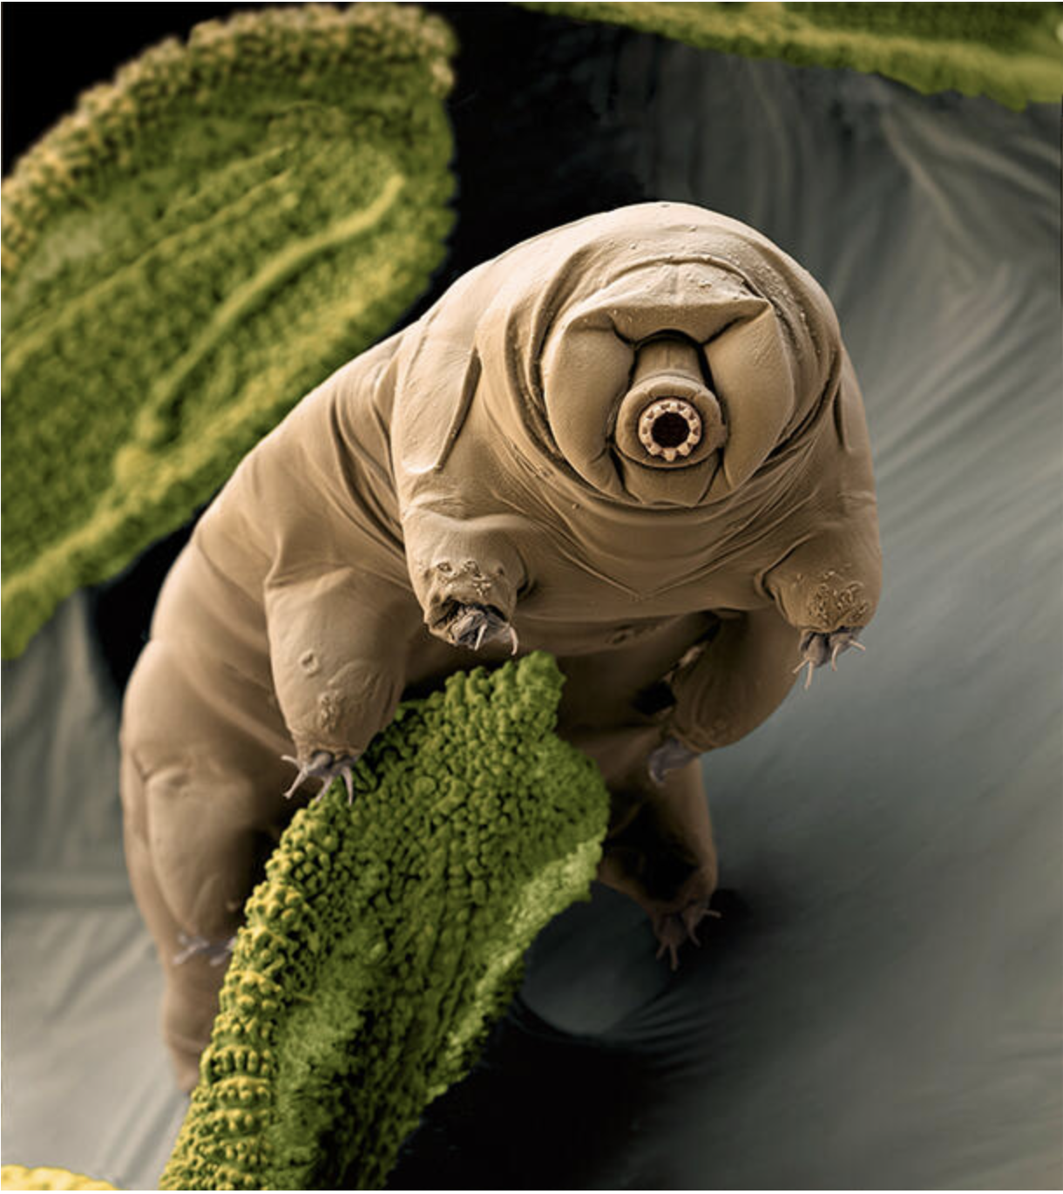
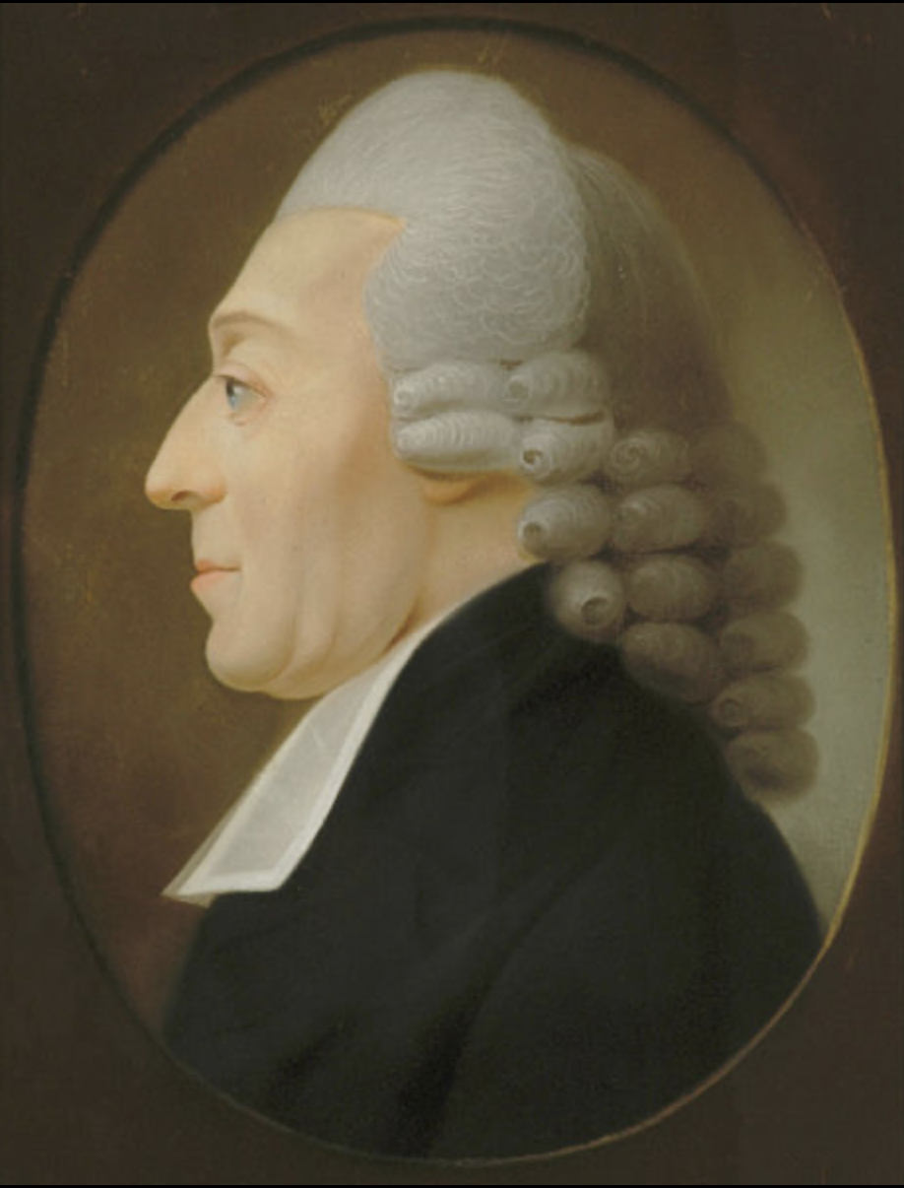
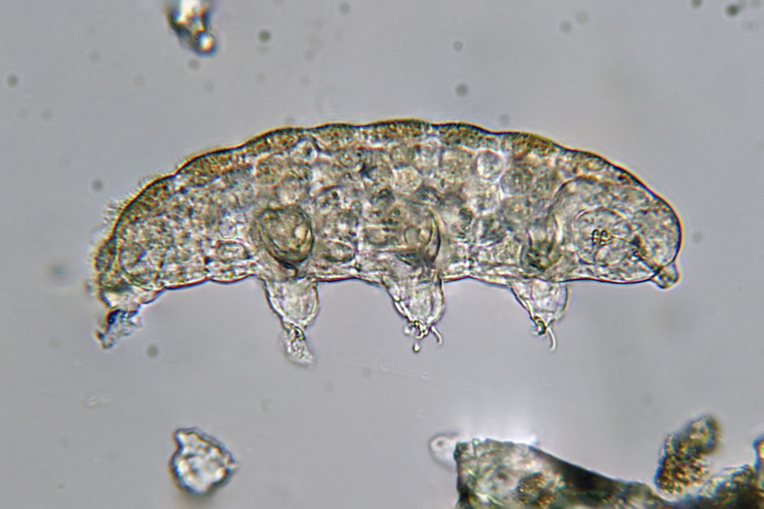
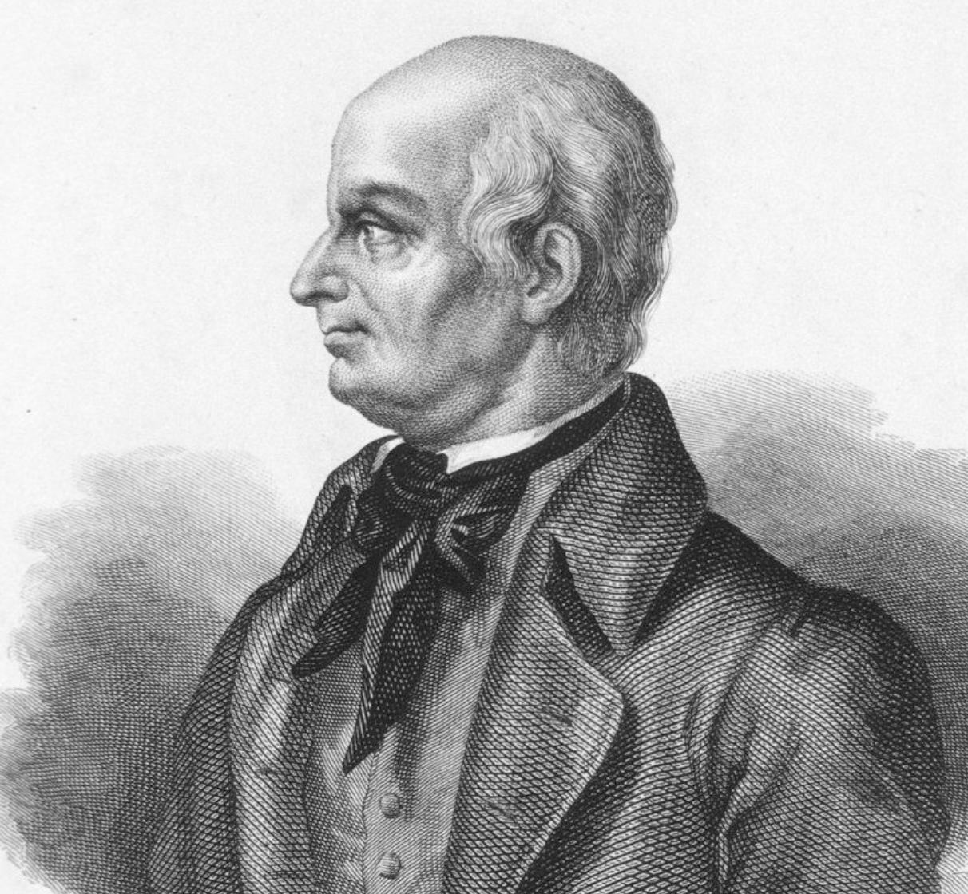
What Are Tardigrades?
They are small, opportunistic organisms.
Microscopic, invertebrate, water-dwelling organisms
they are typically 0.3 to 0.5 mm (0.012 to 0.020 in) in length.
Discovered in 1773 by German zoologist Johann Goeze who named them “Kleiner Wasserbär” (small water bear).
In 1776 Italian biologist Lazzaro Spallanzani called them Tardigrada from Latin tardi (slow) gradi (step) because of their slow-moving behavior.

Slide 3
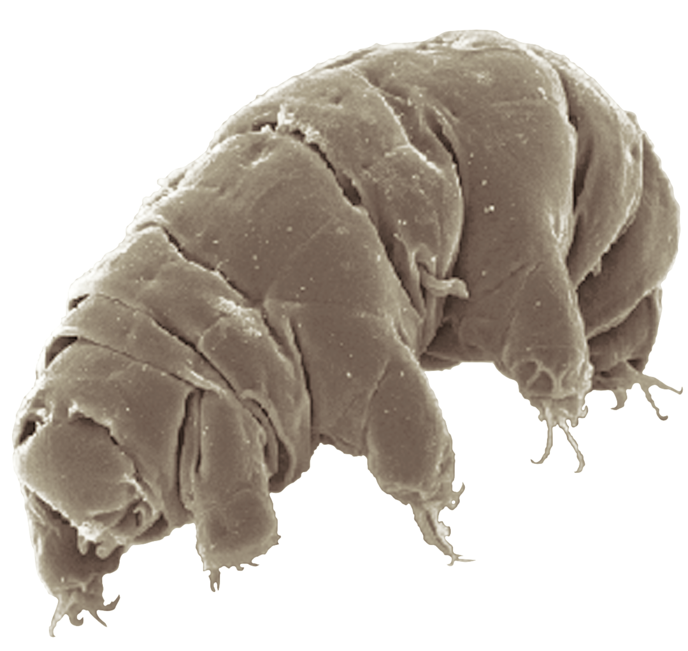
Where do we place Tardigrades?
What kind of creature are they?
Kingdom: Animalia
Multicellular organisms with differentiated tissues and heterotrophic lifestyles (relying on external food sources).
Phylum: Tardigrada
Tardigrada is their unique phylum, making them distinct from all other organisms. More than 1,300 described species.
Superphylum: Ecdysozoa
Tardigrades are grouped with other molting animals (e.g., arthropods and nematodes). This shared characteristic links them evolutionarily.
Notes:
You can find them in rain forests, antartica, everywhere. Been around for 500 mil years and survived 5 mass extinctions.

Slide 4

Why are we talking about tardigrades?

Slide 5
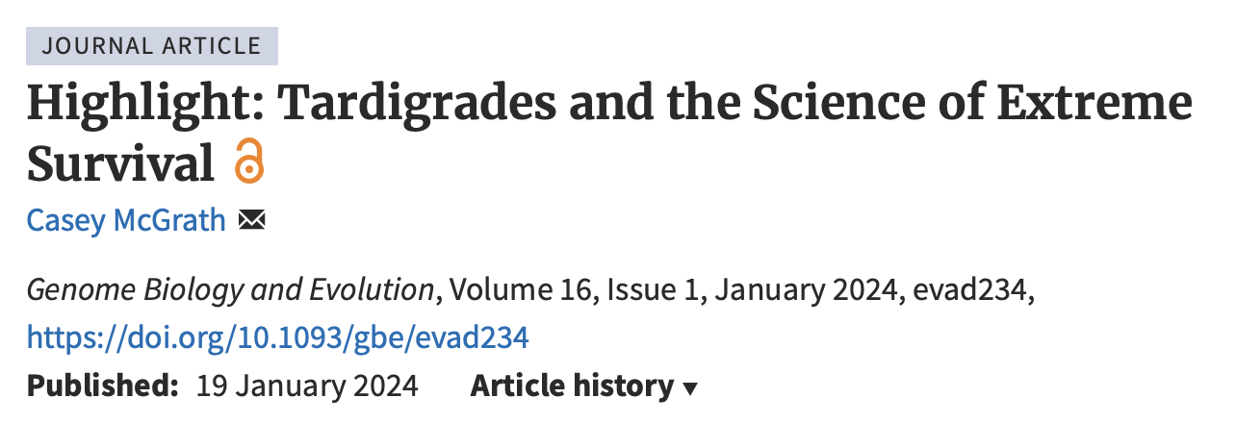
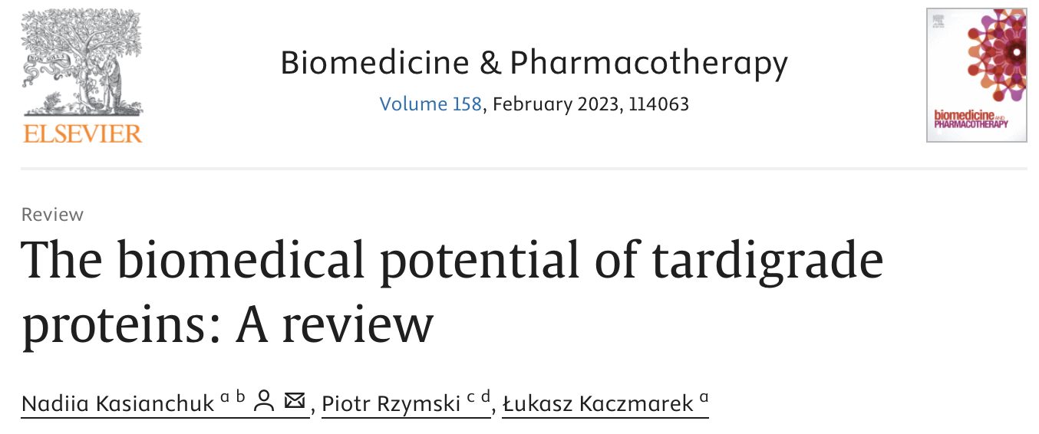
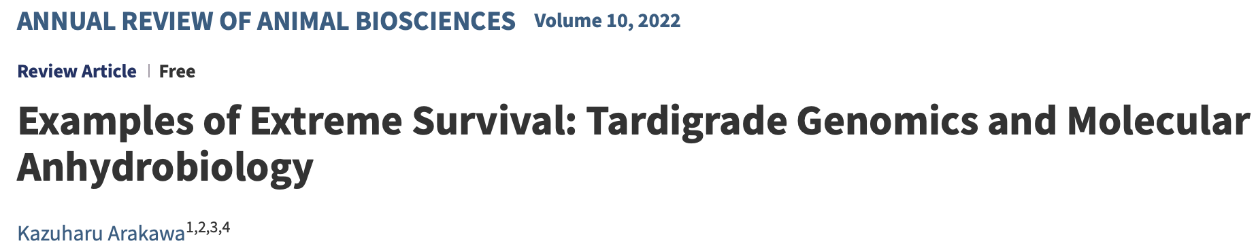
Notes:
Now that Musk wants to ship us all to Mars, we need to know

Slide 6
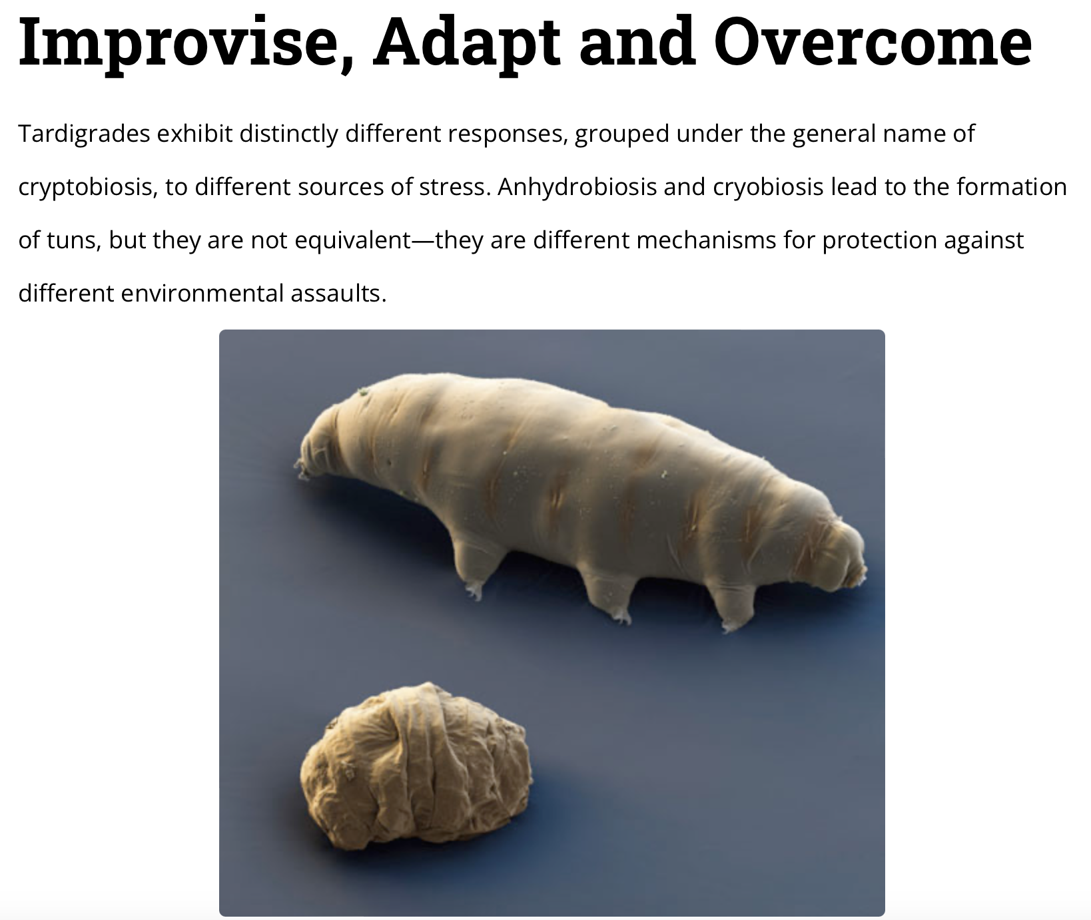
Cryptobiosis: From Greek for “Kryptos (concealed, hidden) and “biosis”: life process
https://www.americanscientist.org/article/tardigrades

Slide 7
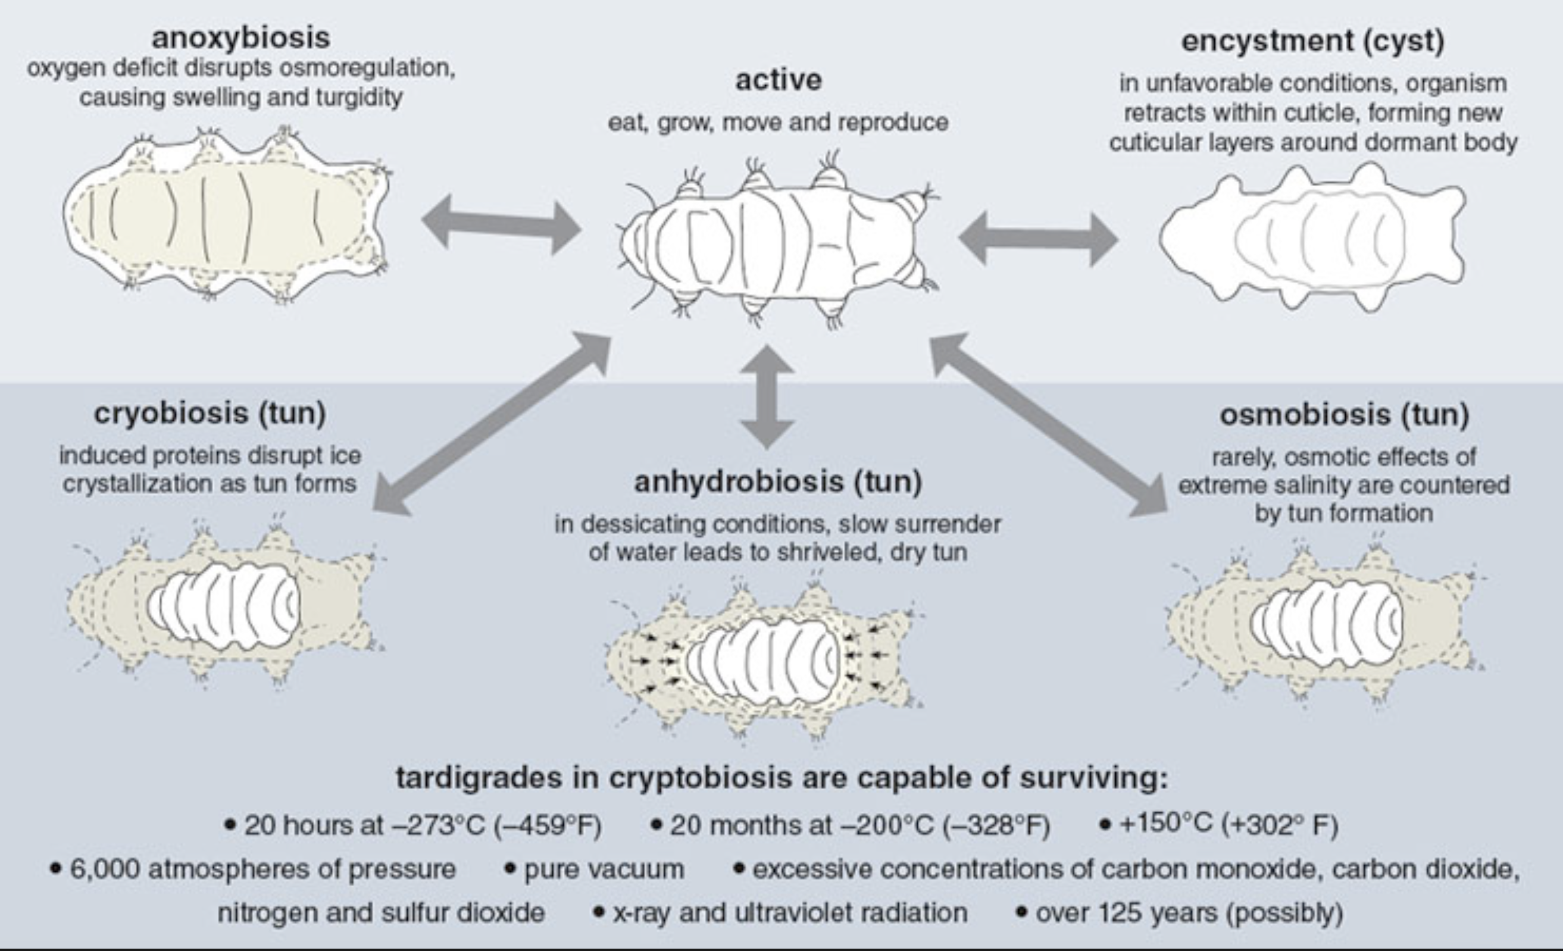
https://www.americanscientist.org/article/tardigrades
Notes:
If change is sudden, they die. It takes 24h for them to become Tun, and 30min to rehydrate and expand back. 0.47 atm to 6 atm is our limit for pressure. As for Grays, we die with about 5-10 grays. Ideed, survival in both conditions depends on how fast or gradual the change is in order for them to have the time to defend.

Slide 8
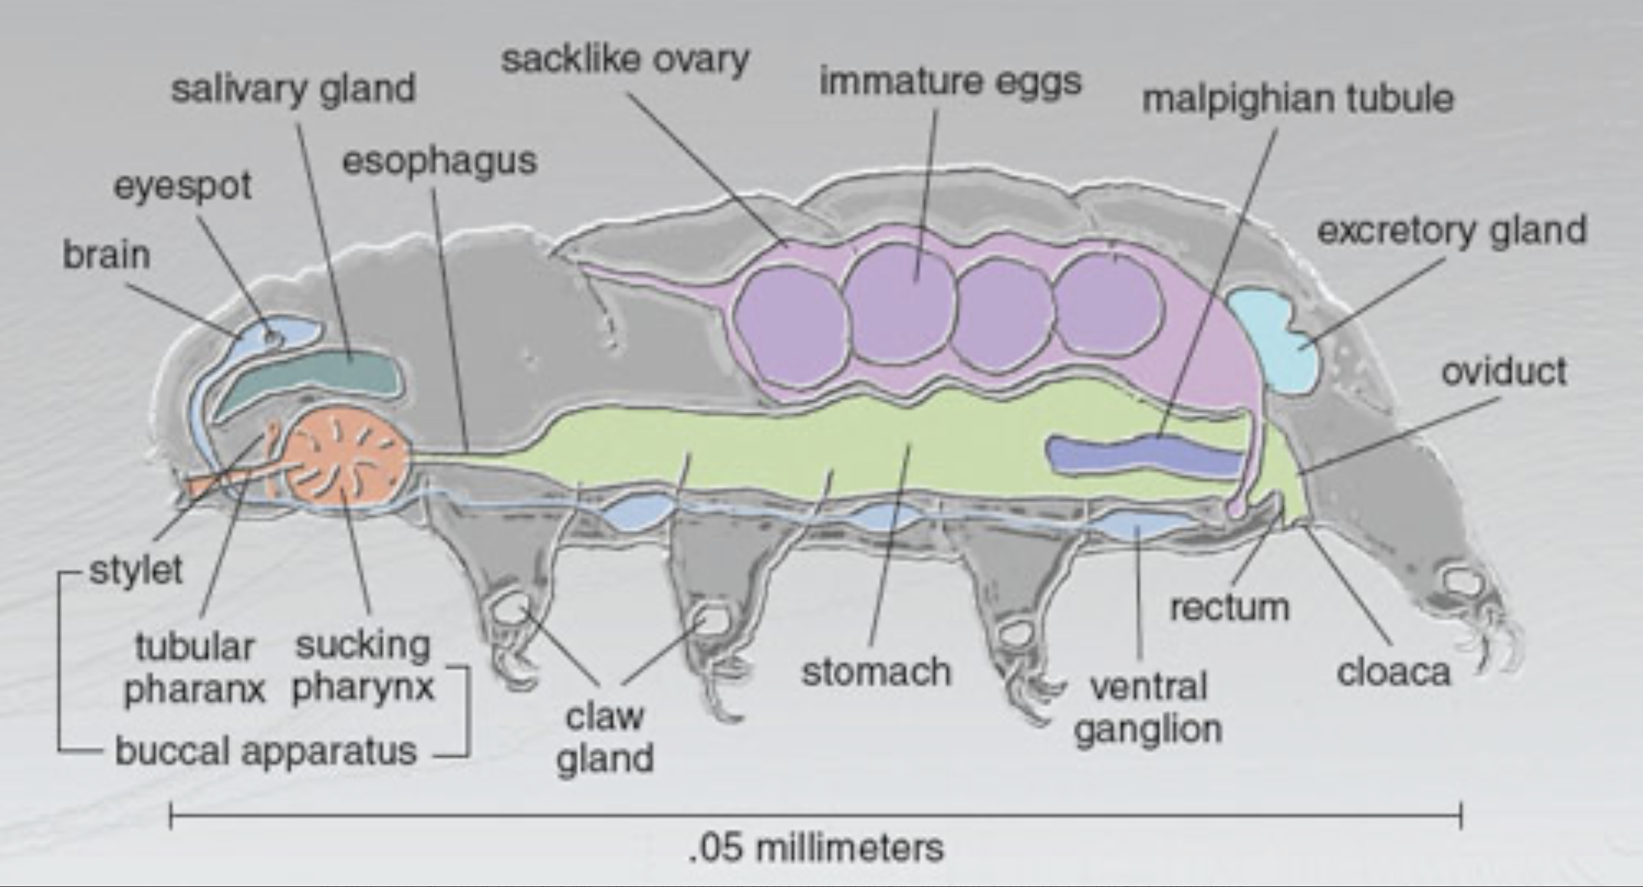
https://www.americanscientist.org/article/tardigrades
Notes:
Like many of us Tardigrades have no heart!

Slide 9
What’s their secret?

Slide 10
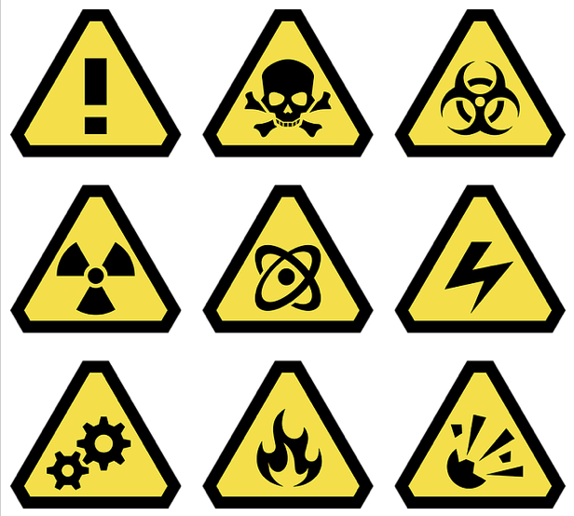
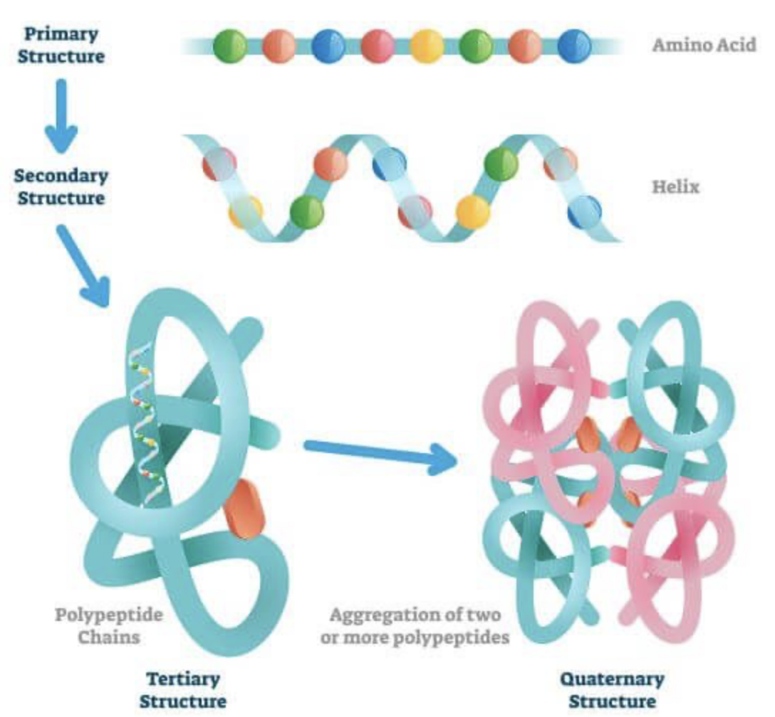
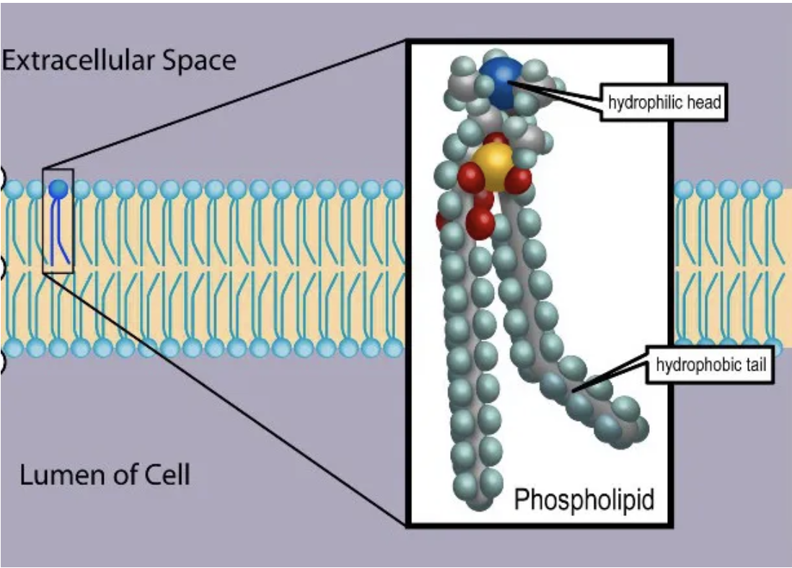
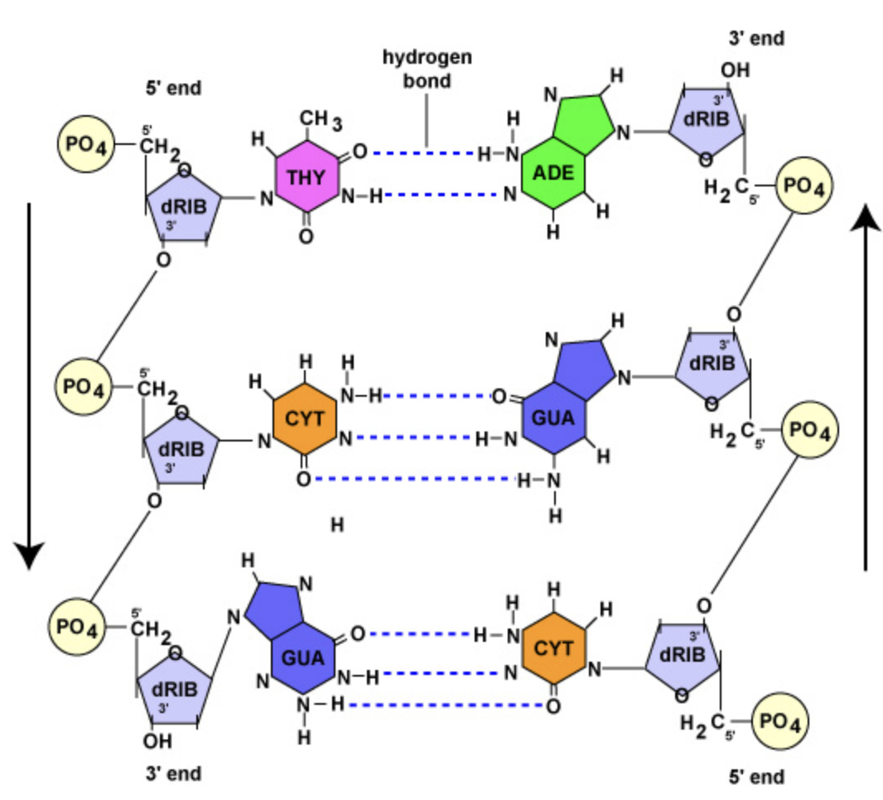
(Bio)Hazard!
What is a hazard in terms of life and biological systems?
Extreme temperatures
Extreme pH (acid/base)
Extreme pressures
Dehydration
Irradiation (𝛾-radiation/x-rays/uv-light)
All these hazards pose a threat to our:
Protein integrity
Lipid integrity
Genome integrity
Cells of ALL living organisms depend on proper structural
And functional stability of proteins, lipids and nucleic acids to work

Slide 11
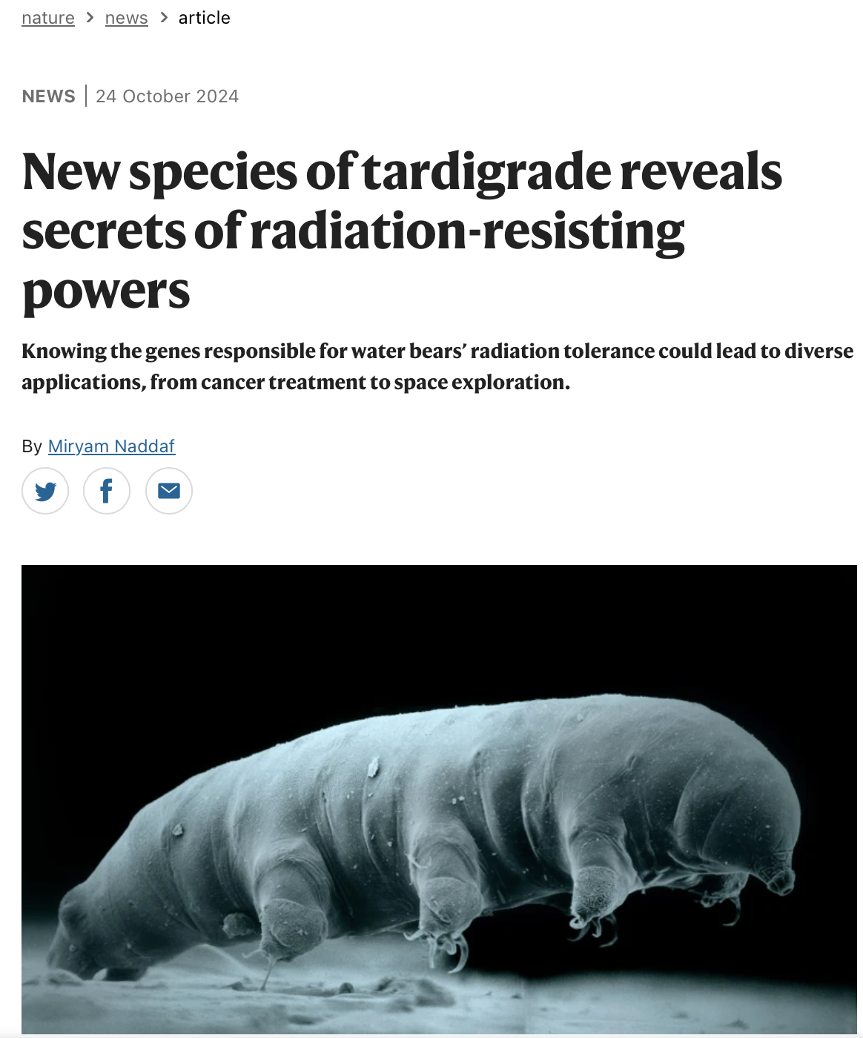
The secrete is in the genome!
Genome sequencing revealed that the species had 14,701 genes, 30% of which are unique to tardigrades.
Researchers exposed Tardigrades to 3000 to 5000 grays (Gy) of gamma rays, which is ∼1000 times the lethal dose for humans.
They found that 2,801 genes involved in DNA repair, cell division and immune responses became active.
One of the genes, called TRID1, encodes a protein that helps to repair double-strand breaks in DNA by recruiting specialized proteins at sites of damage.
The researchers also estimate that 0.5–3.1% of the tardigrade’s genes were acquired from other organisms through a process known as horizontal gene transfer.
Li et al., Science 2024
Notes:
What we do us scientists, when we get nosy and jealous of other organisms, we peek into their genome by sequencing their RNA.

Slide 13
The secrete is in the genome!
Genome sequencing revealed that the species had 14,701 genes, 30% of which are unique to tardigrades.
Researchers exposed Tardigrades to 3000 to 5000 grays (Gy) of gamma rays, which is ∼1000 times the lethal dose for humans.
They found that 2,801 genes involved in DNA repair, cell division and immune responses became active.
One of the genes, called TRID1, accelerates the repair of DNA double-strand breaks by recruiting specialized proteins at sites of damage.
The researchers also estimate that 0.5–3.1% of the tardigrade’s genes were acquired from other organisms through a process known as horizontal gene transfer.
A gene called DODA1, which seems to have been acquired from bacteria, enables tardigrades to produce four types of antioxidant pigments called betalains - can mop up harmful reactive chemicals which account for 60–70% of radiation’s damaging effects.
Li et al., Science 2024

Slide 14
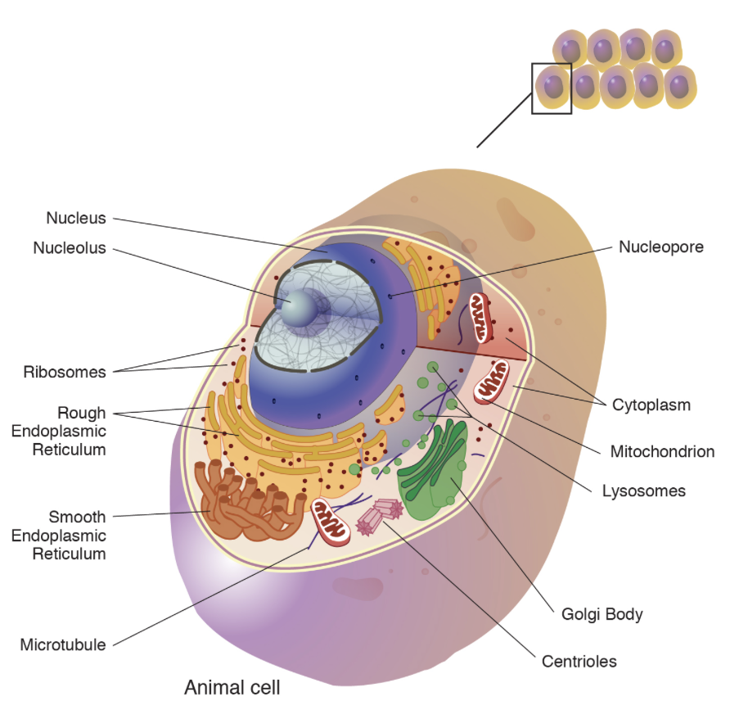
Cryopreservation

Slide 15
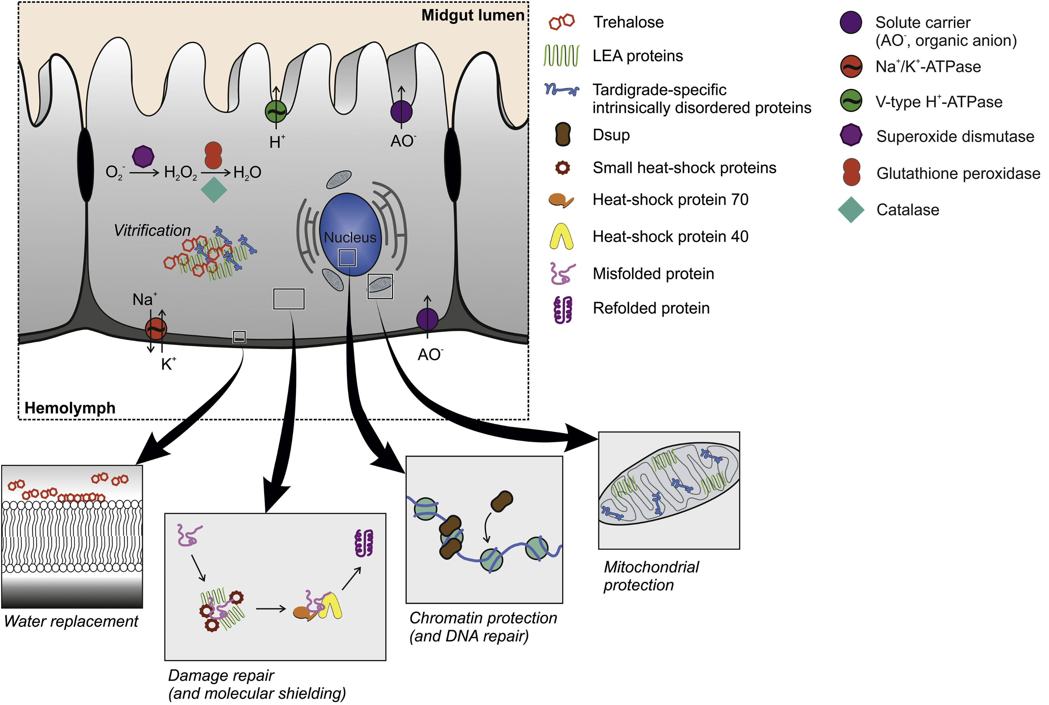
The secrete is in the genome!
Tardigrade specific proteins such as TDPs help maintain protein and lipid stability, along with the sugar trehalose.
Additionally, some TDPs form gels that slow down molecular interactions within cells – thereby slowing metabolism.
Late Embryogenesis Abundant (LEA) proteins, also found in plant seeds, maintain structural stability during desiccation.
Trehalose and glycerol act to both preserve osmotic pressure when water and ions are pumped out and as acute, immediate anti-freeze agents.
Trehalose and glycerol help maintain lipid membrane fluidity.
Nadja Møbjerg, Ricardo Cardoso Neves, Comparative Biochemistry and Physiology, 2021

Slide 16
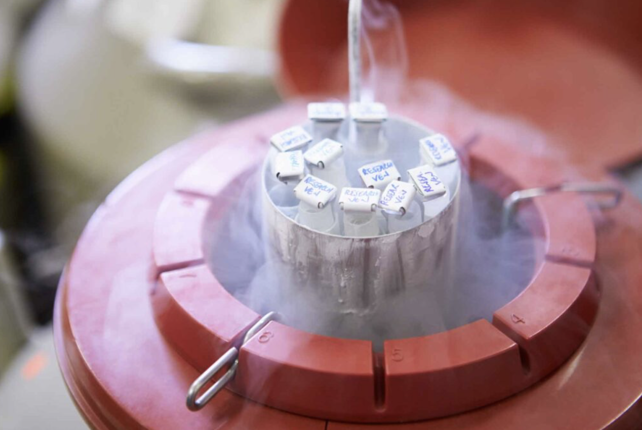
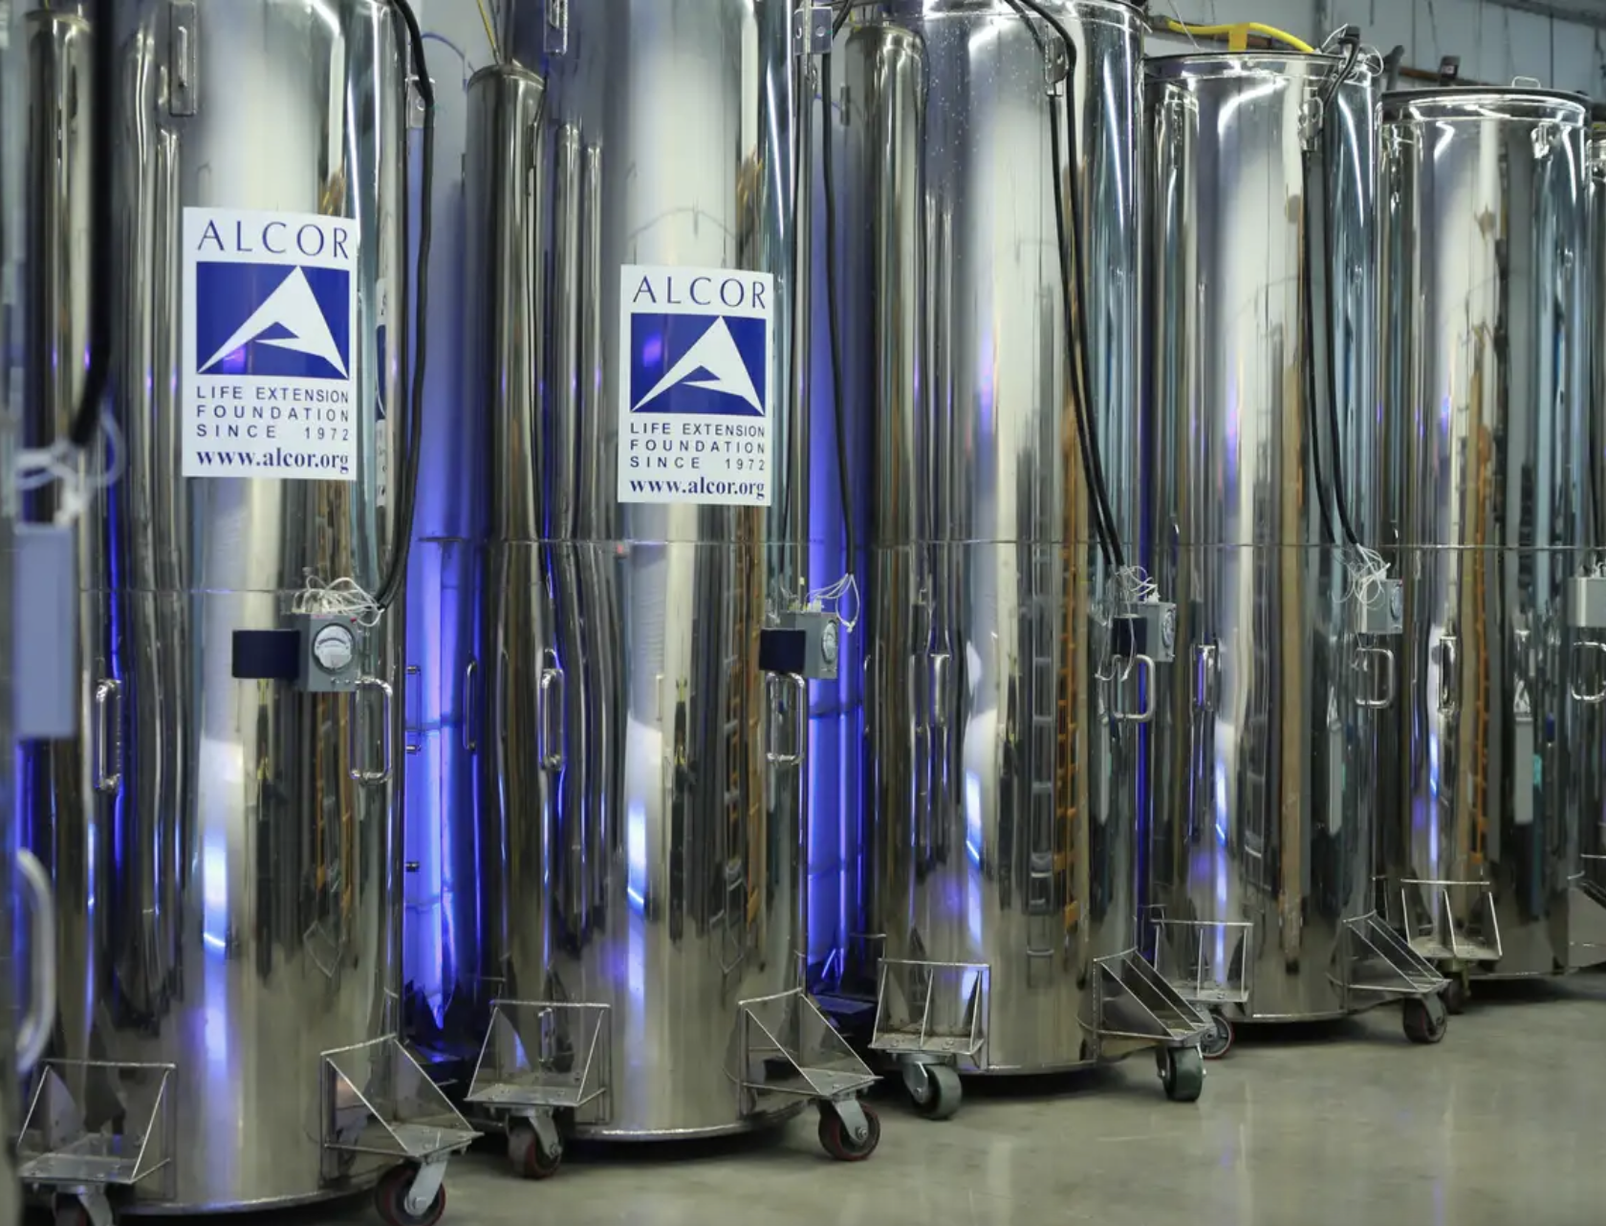
Cryopreservation
We now routinely cryopreserve cells and embryos (up to 7-8 days post fertilization).
Trehalose and glycerol can be used to cryopreserve cells.
Serum albumin is added to provide stability.
We can apparently also cryopreserve whole humans…
But we don’t know how to wake em up!
We can learn a lot from Tardigrade at the cellular and molecular level!

Slide 17
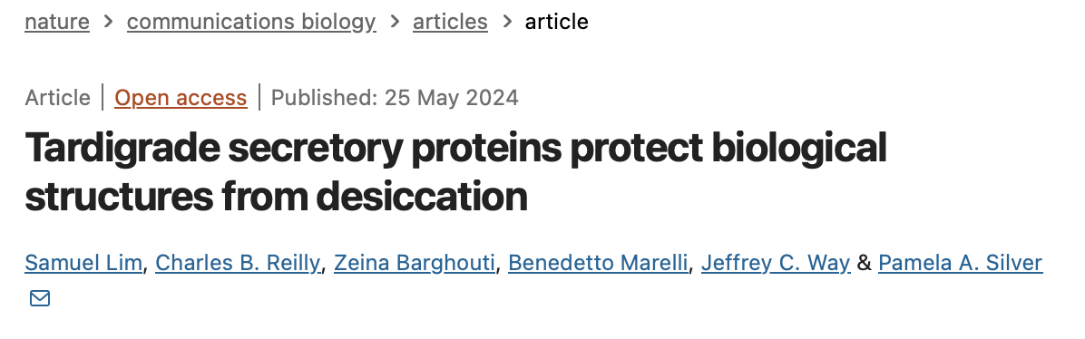
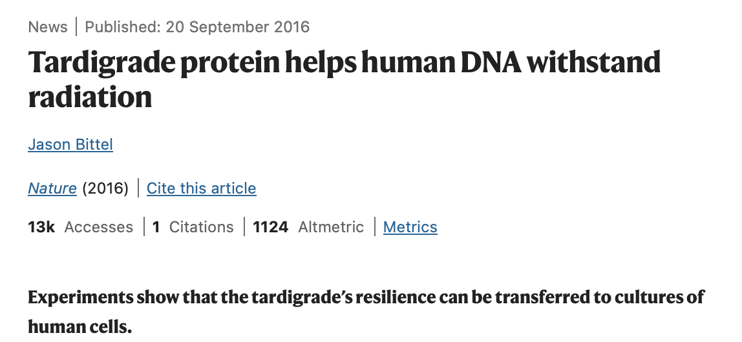
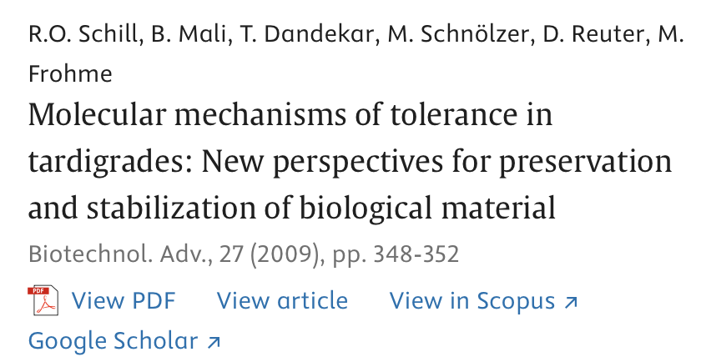
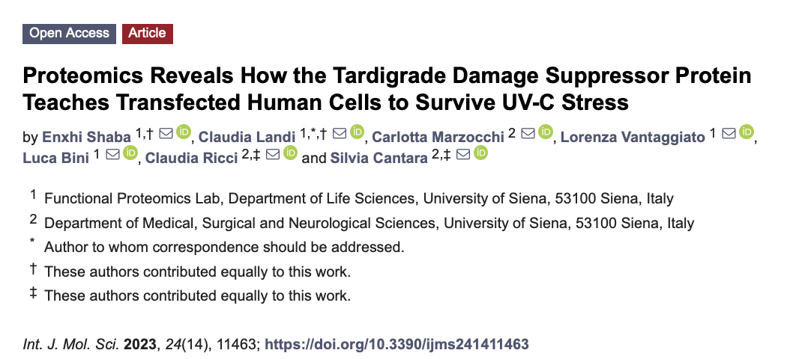
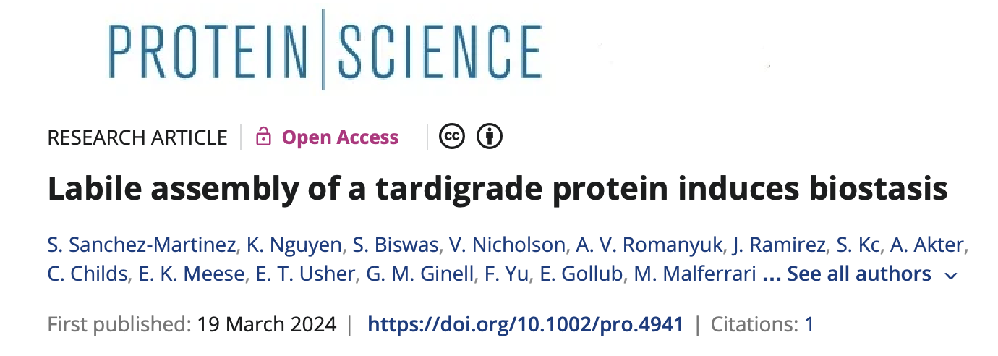
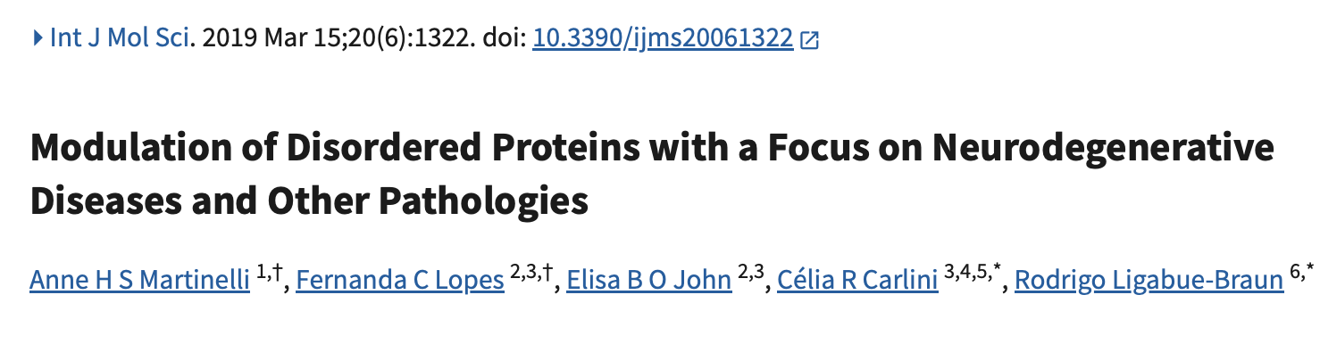
Potential Future Applications

Slide 18
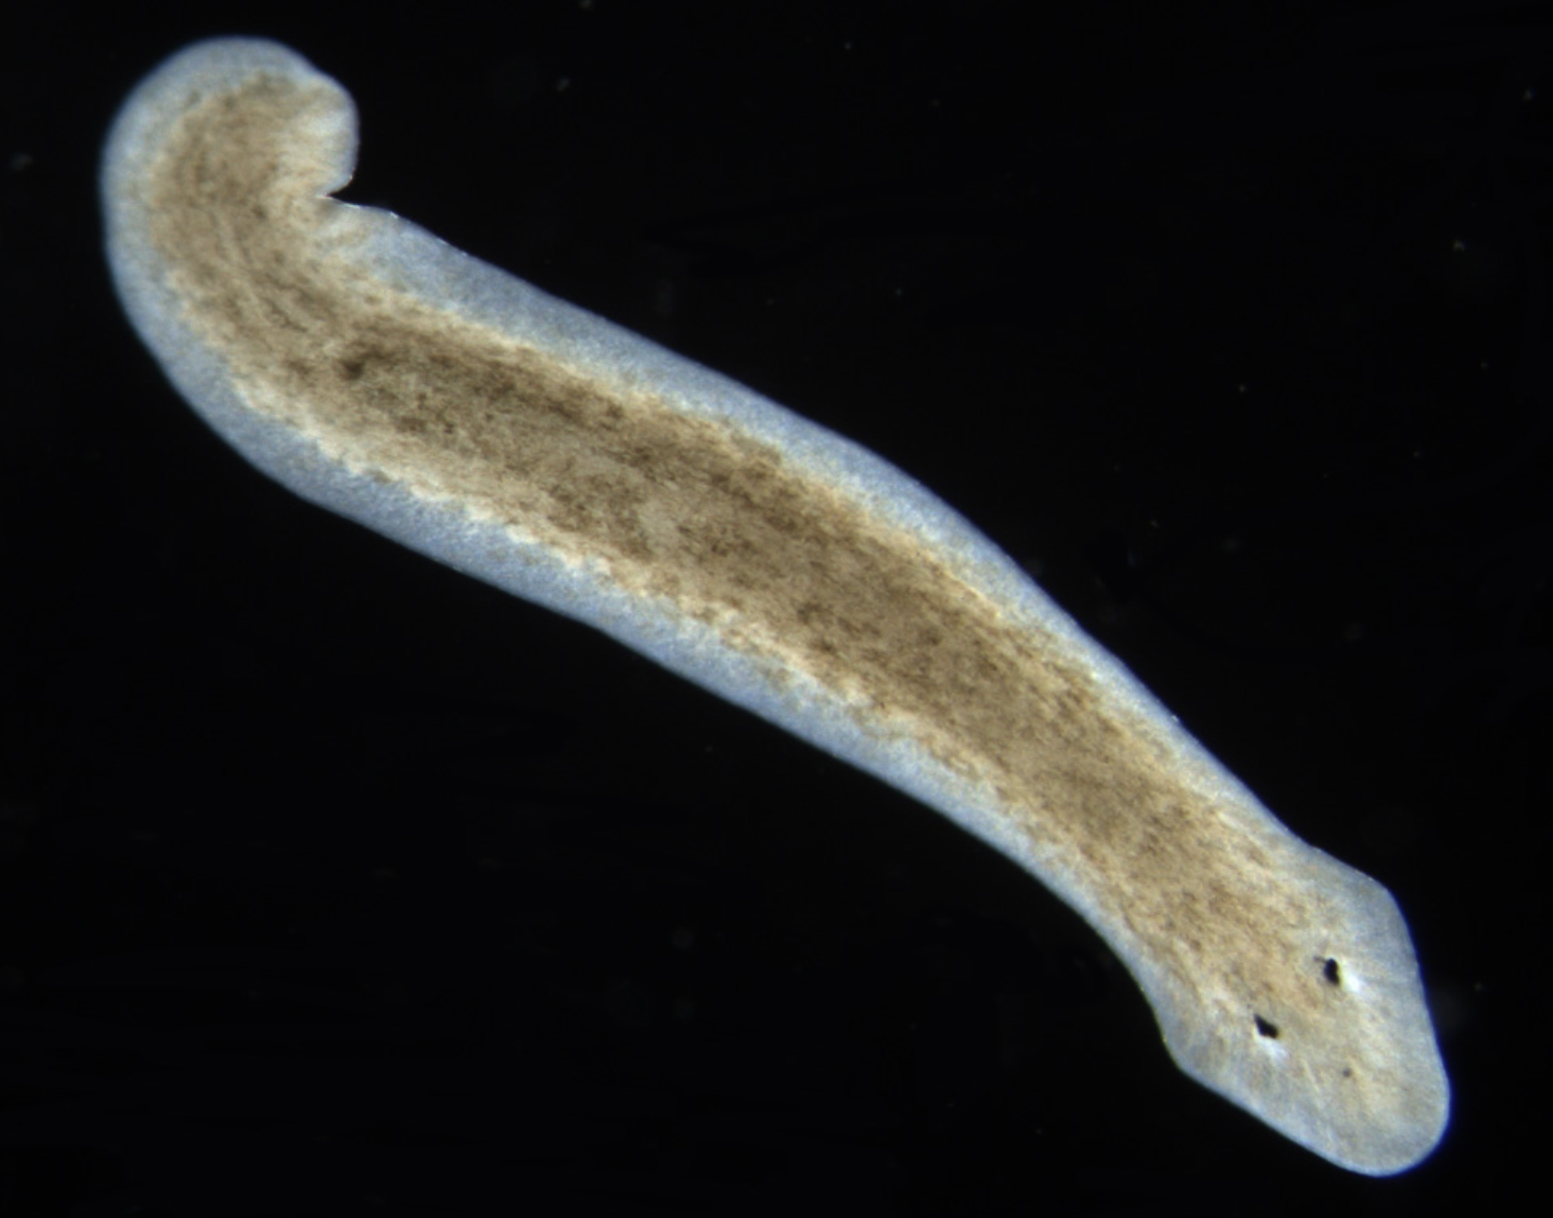
IS RESILIANCE = LONGEVITY?
Not necessarily
Tardigrades live up to 2 years in their hydrated form and decades in their tun-form.
This is still long compared to similar organisms like nematodes who live several months-1y.
The Planarian flatworms are not as resilient to stressors but the can potentially live forever
- Constant rejuvenation and repair.

Slide 19
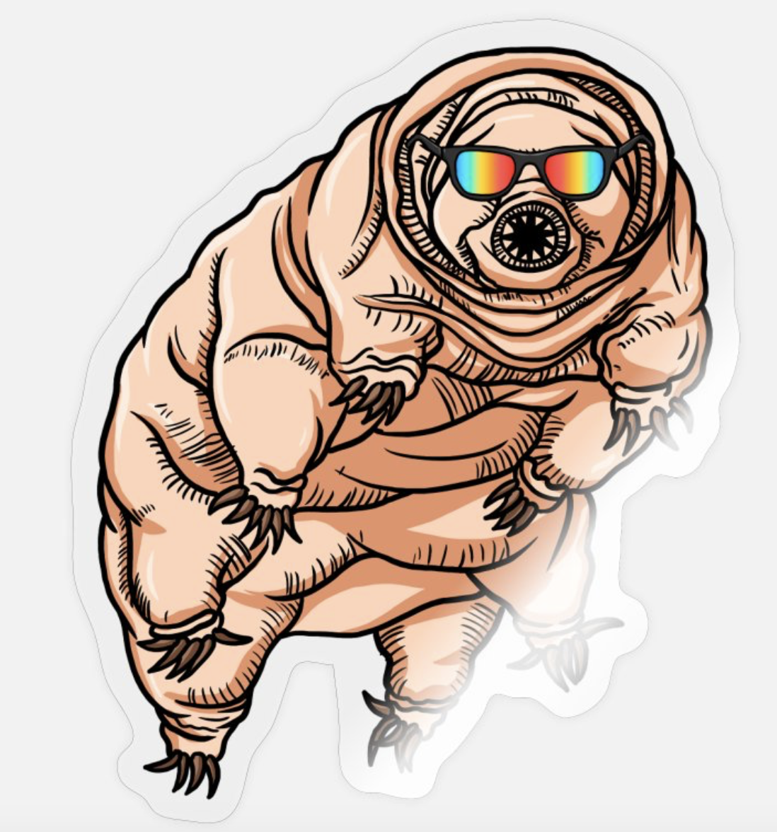
Thank You!
Questions?
That’s All
Folks!

